Slide 1
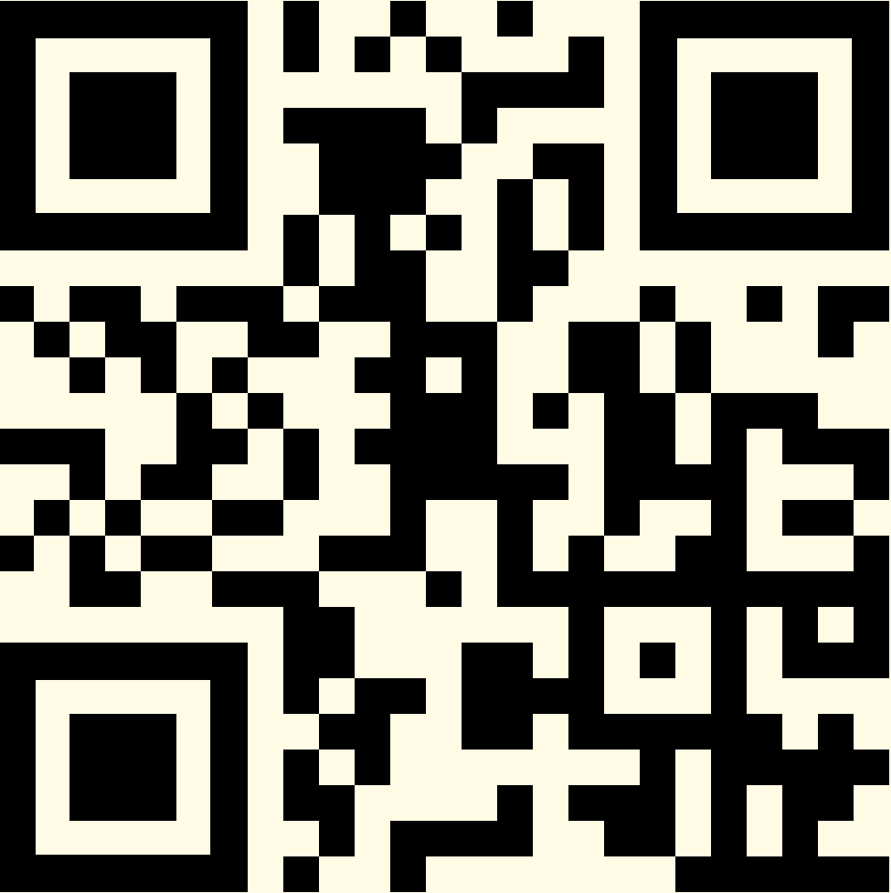
A. Solomon Kurz, Ph.D.
https://solomonkurz.netlify.app/
Clinical strategies
to help Veterans
reclaim their lives
following values work
Slides: https://osf.io/rk56n/

Slide 3
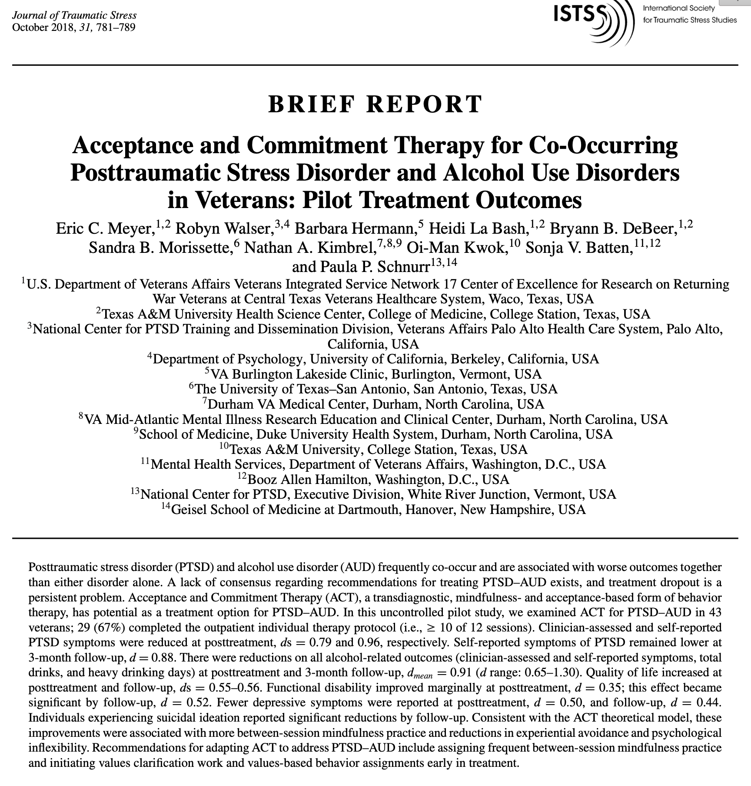
https://doi.org/10.1002/jts.22322

Slide 4
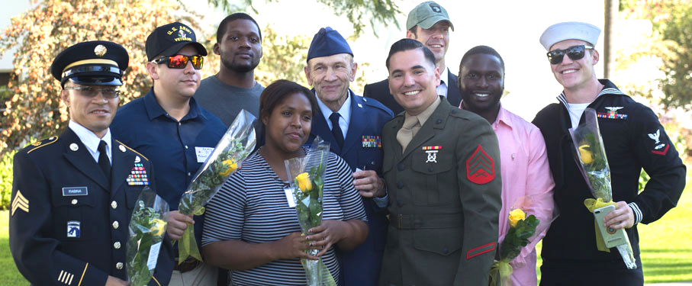
Picture from: https://studentaffairs.lmu.edu/community/studentsuccess/veteranprograms/
Common wounds of war
chronic pain
depression
heavy substance use
post-traumatic stress
traumatic brain injury

Slide 6
compassion | creativity | recognition | pleasure
safety | freedom | justice | intellect
independence | support | kindness | fun
adventure | surrender | reliability | courage
vitality | dependability | love | learning
integrity | self-respect | success | respect
equanimity | humor | dignity | service
passion | discovery | connection | empathy
faithfulness | patience | spontaneity | sacredness
engagement | contribution | growth | gratitude
trust | loyalty | play | honor
nurture | grace | honesty | truth
understanding | openness | appreciation | tradition

Slide 9
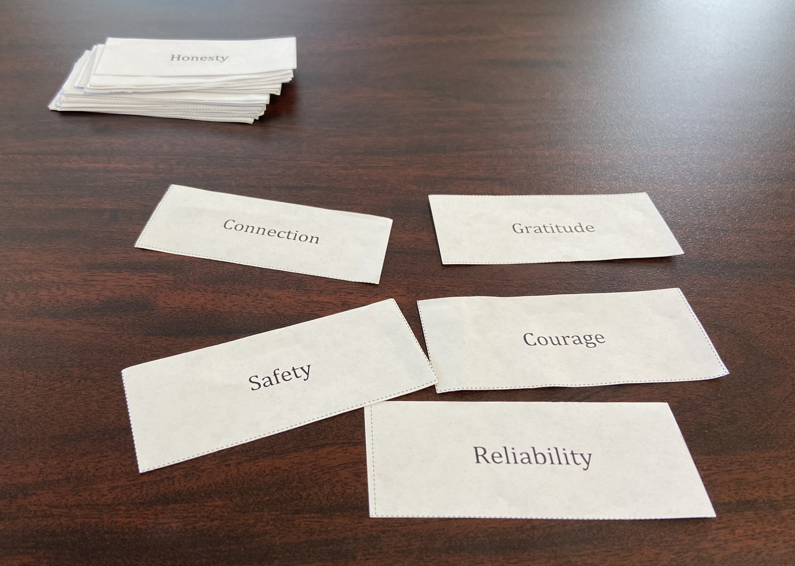

Slide 10
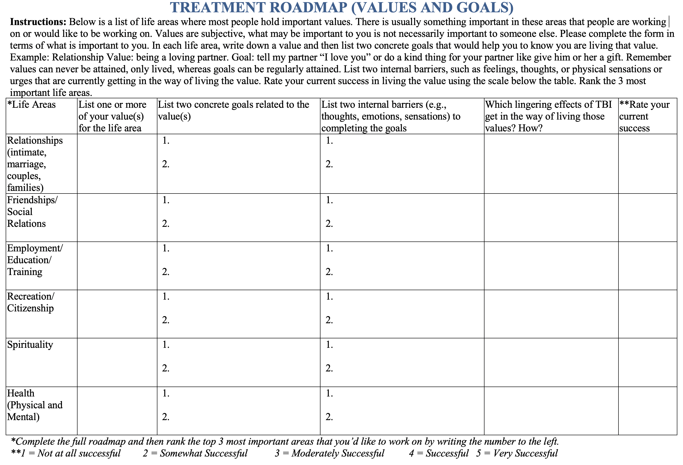

Slide 16
Authors
A. Solomon Kurz, PhD¹ a.solomon.kurz@gmail.com
Suzannah K. Creech, PhD¹ Suzannah.Creech@va.gov
Joseph Mignogna, PhD¹ Joseph.Mignogna@va.gov
Eric C. Meyer, PhD^{1,2} Eric.Meyer2@va.gov
¹ VA VISN 17 Center of Excellence for Research on Returning War Veterans at Central Texas Veterans Healthcare System
² Department of Psychiatry, Texas A&M University Health Science Center, College of Medicine, and Department of Psychology and Neuroscience, Baylor University
Acknowledgements
This research was supported by a VA Merit Award #I01RX000304 to S. B. Morissette, PhD, and RX000304-04A1 to Drs. Meyer and Morissette from the Rehabilitation Research and Development Service of the VA Office of Research and Development (ORD), the Department of Veterans Affairs VISN 17 Center of Excellence for Research on Returning War Veterans, and the Central Texas Veterans Health Care System.
This presentation was also supported by the Office of Academic Affiliations, Advanced Fellowship Program in Mental Illness Research and Treatment, Department of Veterans Affairs.
The views expressed in this article are those of the authors and do not reflect the official policy or position of the Department of Veterans Affairs or academic affiliates.

Slide 17
Thank you
More about Solomon:
https://solomonkurz.netlify.app/
Materials and slides:
https://osf.io/rk56n/

